Slide 1
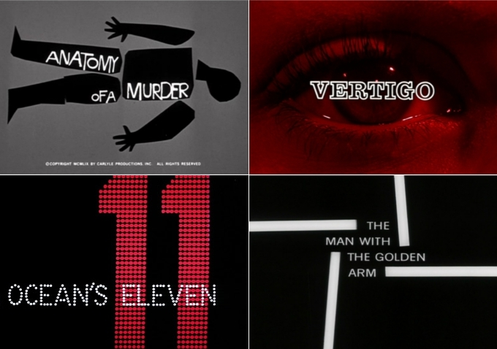
Title Sequences
Objectives :
Understand and comment on their purpose
Use key terms in doing this
Use this as a basis for own analysis to develop creativity

Slide 2
What’s in it for me?
Planning (20%)
‘research into similar products and a potential
target audience’
Production (60%)
using varied shot transitions and other effects
selectively and appropriately for the task set;
Evaluation Questions (20%)
understanding of issues around audience,
institution, technology, representation, forms and
conventions in relation to production.

Slide 3
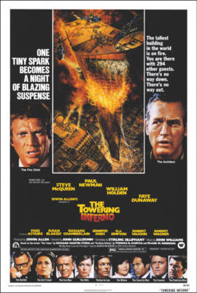
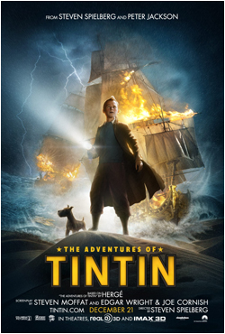
Marketing

Slide 4
Institutions / Studio and Distributor
A Distributor books the films into cinemas and spends millions on marketing campaigns for the film.
Brand identity / reputation / marketing
Produces and distributes big budget commercial films like Avatar
Distributes quality independent and arthouse films e.g The King’s Speech

Slide 5
Key Terms
We learn through applying them
Title sequence
Institutional context
(meaning which company makes it and our expectations of the company )
Mainstream Cinema(mass market) v Independent or Arthouse
Cinema (smaller niche market)
Design concept / aesthetics or visual style (colour design/filters/animations/font type)
Genre (e.g romance/thriller/musical)
Post production (contemporary v classic styles)
Minimalist or post production heavy
Brand identity and marketing
Above the title (the traditional place to indicate star status)
Connotations
Above the title (positioning of an actor’s name indicating star status)

Slide 6
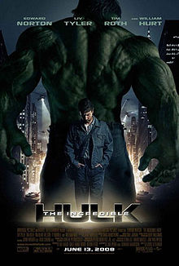
Model Analysis
In this ________ __________ the Marvel Studios Logo creates an
immediate __________ __________ . This context helps to
market this film as well as other Marvel Productions creating a
stronger ___________ identity.
This film is designed for a ________ audience and is clearly
an example of _____________ cinema, meaning that the
narrative within the title sequence should be easy to follow.
The _______ concept relies on a good deal of ___________
____________ . The titles are complex and have been heavily
animated to indicate a sense of the dynamic action of the plot.
Titles are in green which has obvious ____________ with the
central character of The Hulk. The capitalised gun-metal grey 3D
may have military ____________ creating further associations
within the narrative and genre.
The majority of the credits relate to the actors prioritising
the lead actor (Edward Norton) whose name is placed _______the
film title indicating that he is a key selling point. Norton is
frequently associated with non-mainstream ____________ cinema which
may be an indication that the producers are hoping that this will lend this
adaptation some credibility.

Slide 7
Your Turn
Use your key terms to analyse your chosen production before feeding back to the class. Cover all of the areas and also find as many additional points of analysis as possible.
- Domino
- Seven
- Nightwatch
- Buried
- Sweeney Todd
ASSESSMENT IN 2 WAYS – OBSERVATION IN TERMS OF GROUP CONTRIBUTION AND TO PRESENTATIONS AS WELL AS QUALITY OF THE ACCOMPANYING H/W. THIS WILL CONTRIBUTE TO YOUR FINAL C/W MARK. GOOD LUCK FILM ANALYSTS!

Slide 8
Good Presentations | Poor Presentations
Key Terms used regularly and appropriately | Key terms not used
Institutional context discussed – type of film company and how they market themselves | Vague thoughts on film companies suggesting little analysis
Key personnel considered as selling point | Little consideration of personnel as selling points
Design concepts analysed in detail ( fonts / animation /colour design and post-production) with correct terminology | Vague and general consideration of the design concept
Fluent and confident delivery | Uncertain delivery indicating lack of preparation

Slide 9
Homework
Write up an analysis of the
opening to a thriller of your choice – O.K the
film with me first!
The best will use all the key terms, offer analysis
as well as demonstrate ability to apply m/e/c/s.

